Slide 1


EtDetectorV1
Mars Sample Return Campaign
Dan Ciubuc
Luís Fonseca
Tiago Cortez

Slide 2
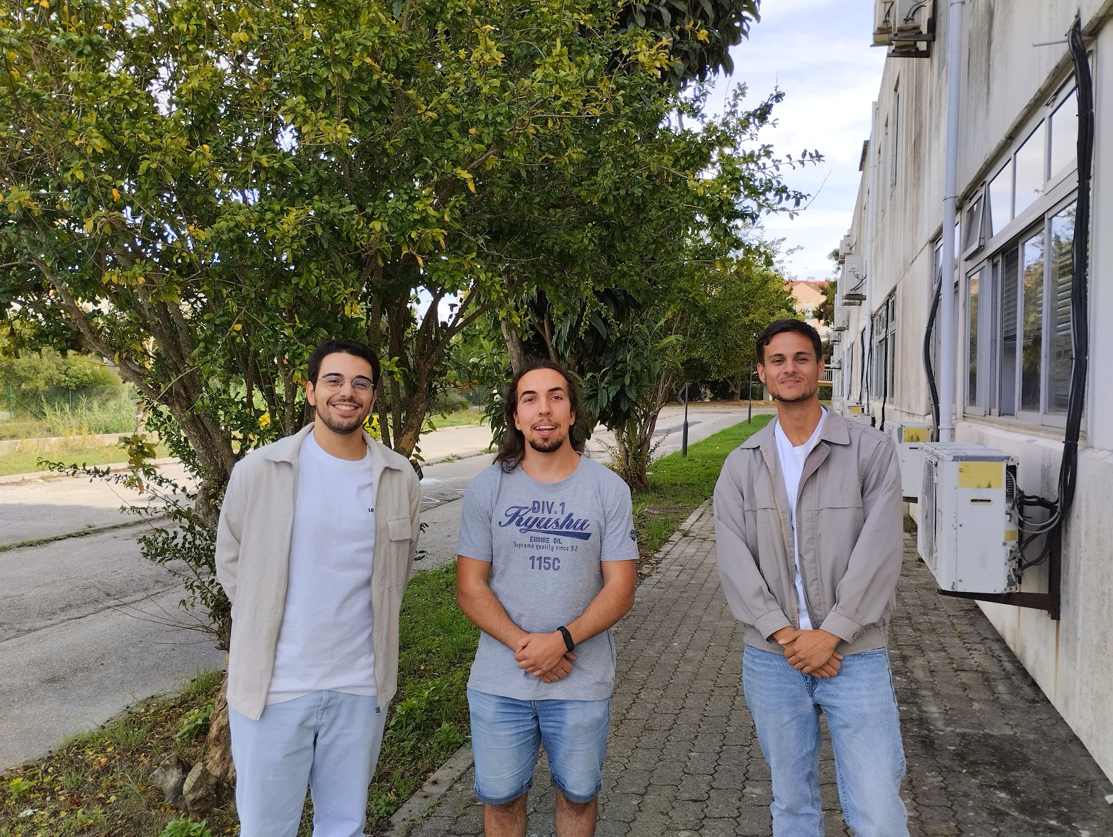
The Team
Luís Fonseca – Completed the Master’s in Micro and Nanotechnology
Tiago Cortez – 2nd year of Master’s in Electronics and Computers
Dan Ciubuc - 3rd year of Bachelor’s in Computer Science
Samsung Innovation Campus Robot Object Detection 1

Slide 3
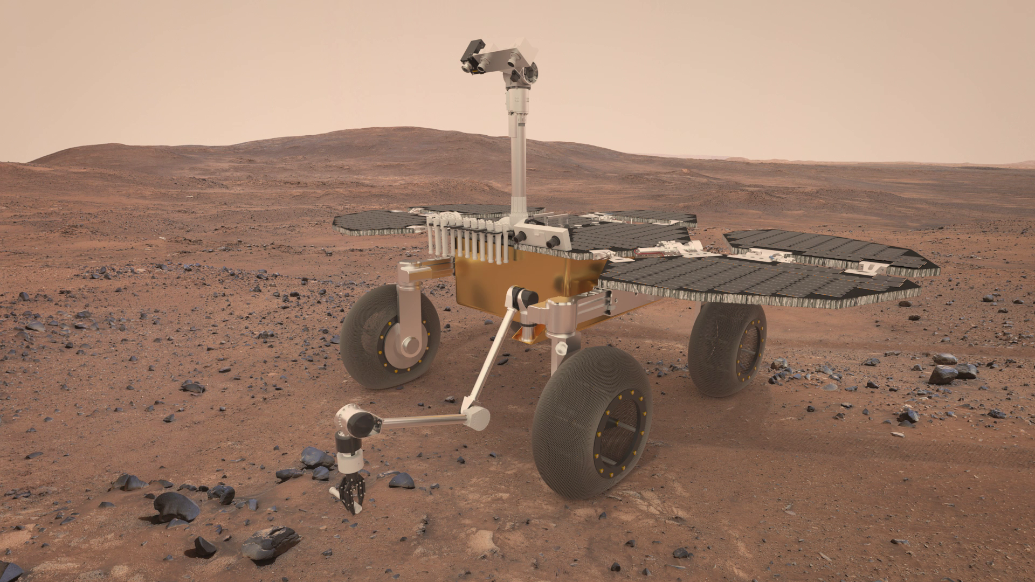


Introduction
EtDetectorV1
One model for all space exploration
Samsung Innovation Campus Robot Object Detection 2

Slide 4
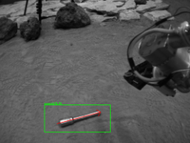
Introduction
Perseverance’s job:
Our goal:
Samsung Innovation Campus Robot Object Detection 3

Slide 5
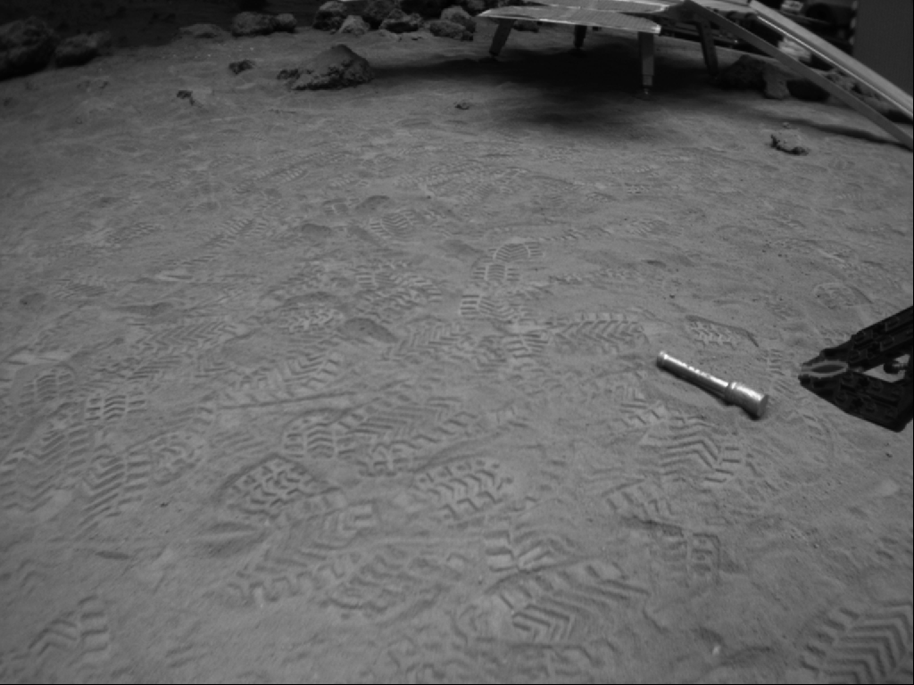



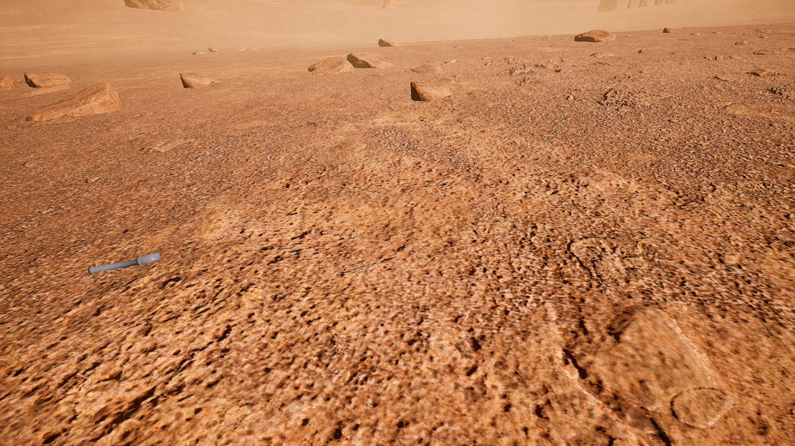
Data Collection and Preprocessing
Real
2060 images
(1024x768x1)
602 images
Synthetic
(1280x720x3)
Samsung Innovation Campus Robot Object Detection 4

Slide 6
Data Collection and Preprocessing
 | Real | Synthetic
Total | 2060 | 602
Position Dataset | 55 | 602
Samsung Innovation Campus Robot Object Detection 5

Slide 7
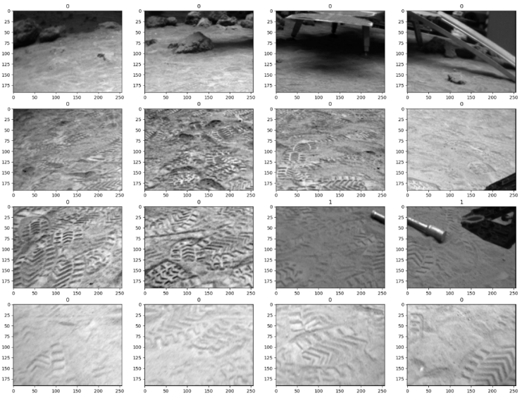
Exploratory Data Analysis
Samsung Innovation Campus Robot Object Detection 6

Slide 8
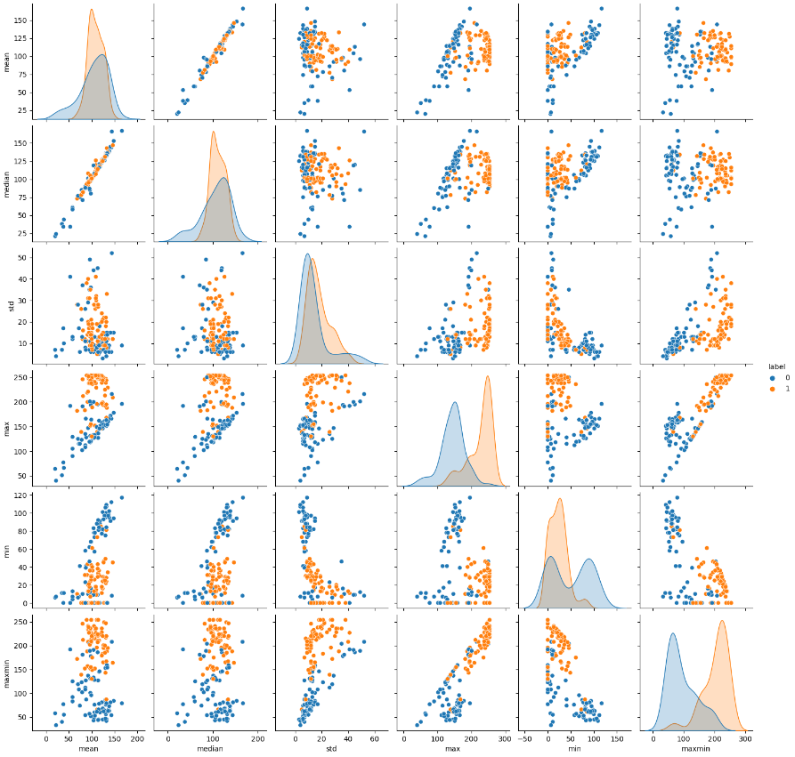
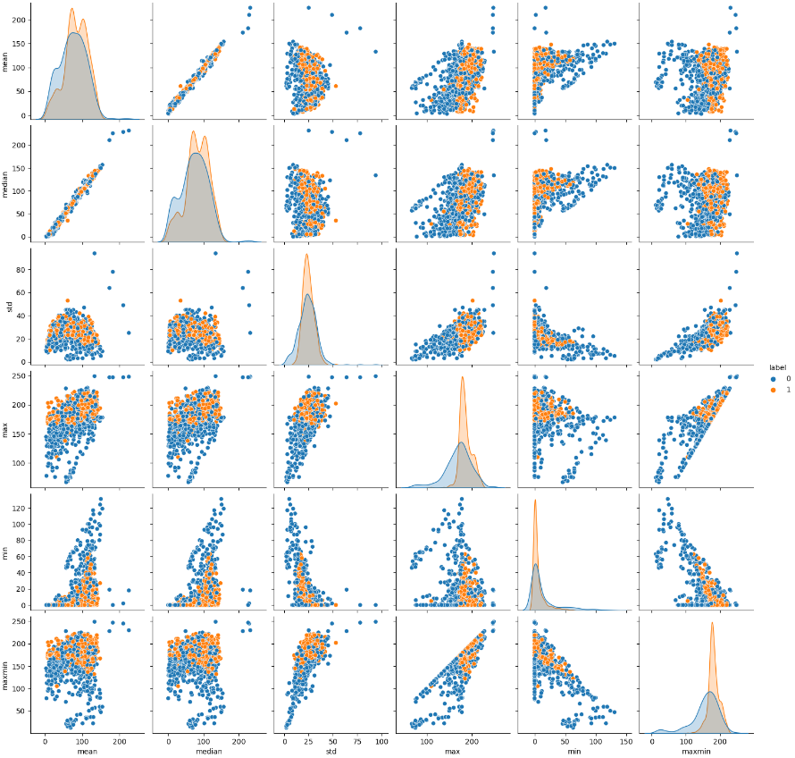
Exploratory Data Analysis
Real images:
Synthetic images:
Samsung Innovation Campus Robot Object Detection 7

Slide 9

Baseline Model
Classification Machine Learning Model
Samsung Innovation Campus Robot Object Detection 8

Slide 10
Results – Machine learning
 |  | Predicted
 |  | Negative | Positive
 | Negative | 364 | 31
 | Positive | 0 | 7
Actual
Balanced accuracy score: 95,9%
Samsung Innovation Campus Robot Object Detection 9

Slide 11
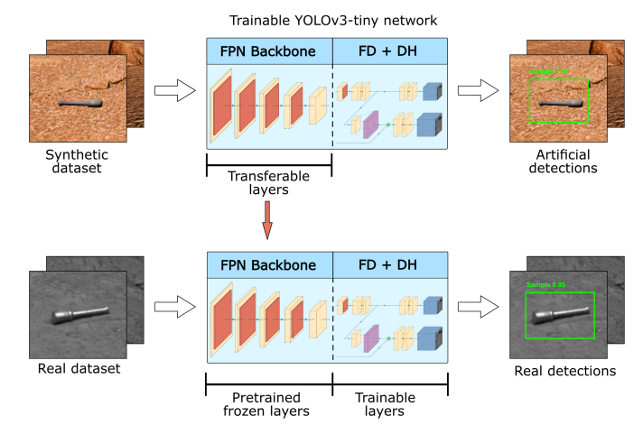
Deep Learning Model
Samsung Innovation Campus Robot Object Detection 10

Slide 12
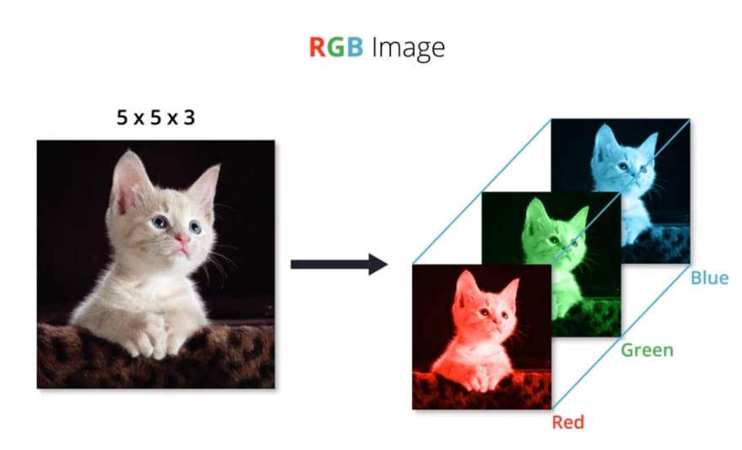
Deep Learning Model
Samsung Innovation Campus Robot Object Detection 11

Slide 13




Deep Learning Model
Training process
Samsung Innovation Campus Robot Object Detection 12

Slide 14
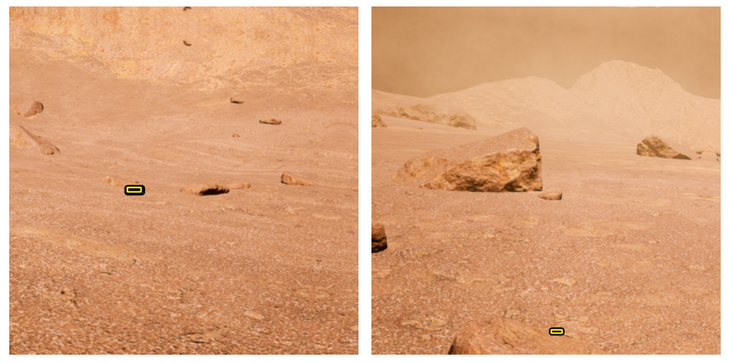
Results – Deep Learning
Samsung Innovation Campus Robot Object Detection 13

Slide 15
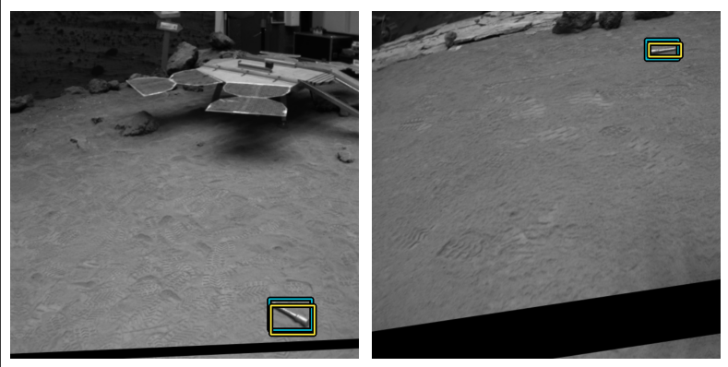
Results – Deep Learning
Samsung Innovation Campus Robot Object Detection 14

Slide 16
Conclusion
Samsung Innovation Campus Robot Object Detection 15

Slide 17
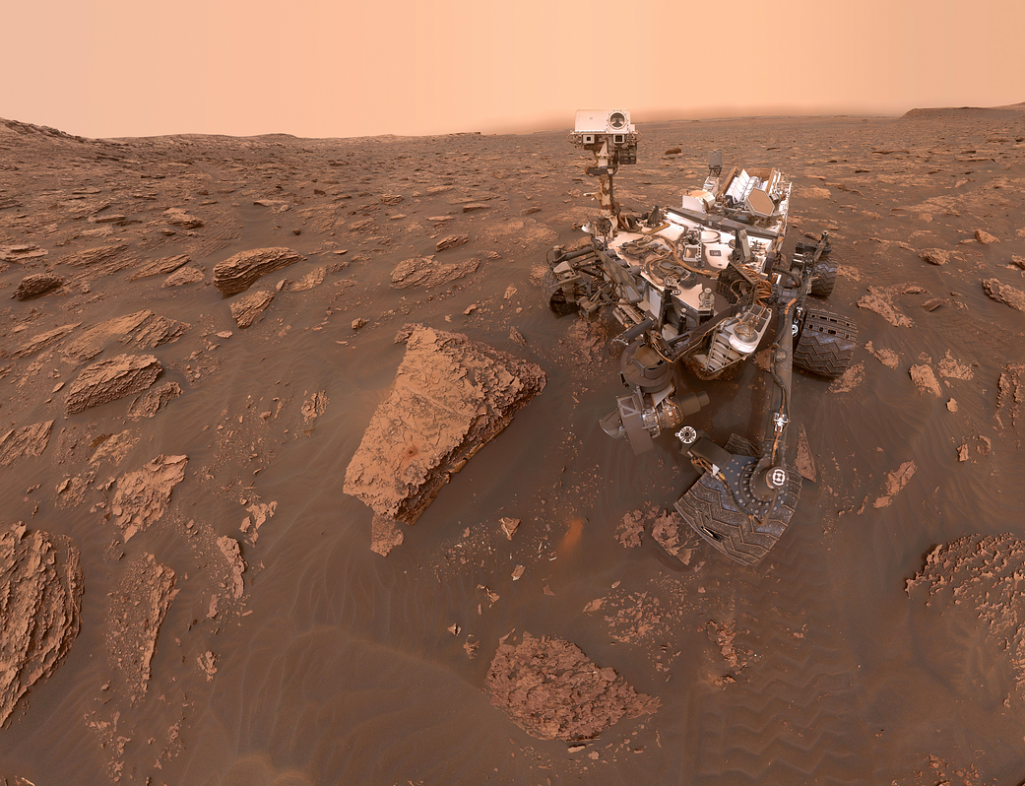
Future work
Higher quality dataset
Samsung Innovation Campus Robot Object Detection 16

Slide 18
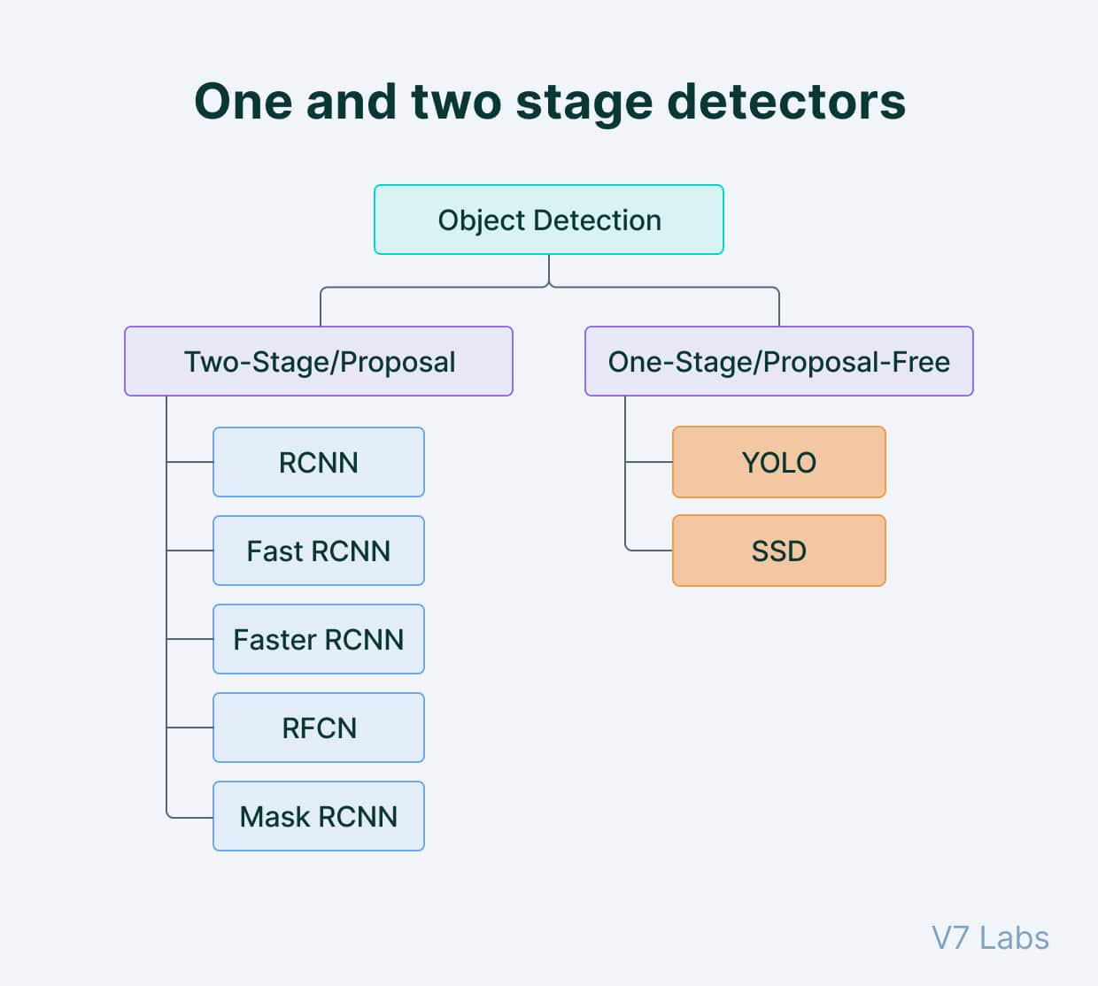
Future work
Other cnn architchures
Samsung Innovation Campus Robot Object Detection 19

Slide 19
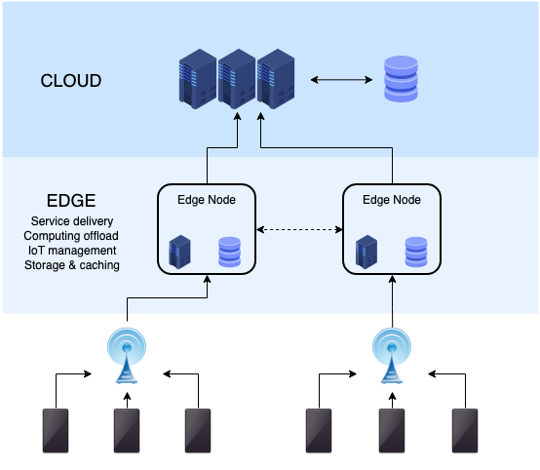
Future work
Edge Computing
Samsung Innovation Campus Robot Object Detection 17

